Slide 1

Advanced Topics in Networking: Special Topics in Internet of Things
Ambuj Varshney
Assistant Professor, National University of Singapore
Wireless, Embedded Intelligence, Sensing, and Emerging Technologies Group
ambujv@nus.edu.sg, http://ambuj.se
Notes:
++ Thank you for inviting me to give this talk
++ In this talk, I will present a pathway that can enable us to make wireless embedded systems ubiquitous. I will describe my previous research efforts that tackle the critical challenges that limit the growth of wireless embedded systems. These are related to the growing energy asymmetry that exists between sensing, computation and communication blocks on these platforms.
++ Finally, I will conclude my talk by covering the research agenda that I would like to work on as a faculty member.

Slide 2
Lecture 4: Wireless Communication for Internet of Things - II
Notes:
++ Over the past few years, I have designed several backscatter and beyond backscatter systems that precisely overcome these critical challenges that have limited the widespread deployment of backscatter on IoT devices.
++ The research vision that I have pursued and would like to pursue as a faculty member is to enable a massive deployment of IoT devices by bridging the energy asymmetry between sensing, computation and communication blocks by designing novel platforms and communication mechanisms. I am going to describe some of my research contributions next.

Slide 3
Administration
Please select papers to be discussed in class (deadline recess week)
Please start to think about the projects for the course
Your focus should be on a good hypothesis and problem statement
Collect evidence to support or go against the hypothesis
We do not expect good significant engineering effort
Notes:
Why do the IoT platforms suffer from this energy challenge? To understand this, we investigate the architecture of the IoT device. We show this architecture in the figure on the slide. It consists of a series of stages that enable us to sense physical phenomena, process and transmit the sensor information through a transceiver such as ZigBee/BLE/LoRa.
This architecture has remained unchanged over the past two decades. We find that during this time, sensors have become exceeding efficient. Today, we find sensors such as an accelerometer or a temperature sensor consumes just a few tens of microwatts of power consumption. However, we find that rest of the architecture components that are shown in red colour remain significantly energy expensive. To understand the reason for this significant energy asymmetry, we look at the following slide.

Slide 4
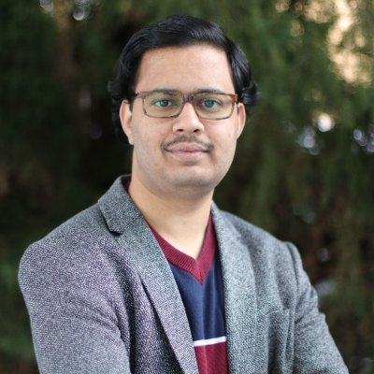
Invited lecture 1: Prof. Akshay Gadre
Assistant Professor at University of Washington, Seattle
Ph.D. from Carnegie Mellon University
Notes:
Why do the IoT platforms suffer from this energy challenge? To understand this, we investigate the architecture of the IoT device. We show this architecture in the figure on the slide. It consists of a series of stages that enable us to sense physical phenomena, process and transmit the sensor information through a transceiver such as ZigBee/BLE/LoRa.
This architecture has remained unchanged over the past two decades. We find that during this time, sensors have become exceeding efficient. Today, we find sensors such as an accelerometer or a temperature sensor consumes just a few tens of microwatts of power consumption. However, we find that rest of the architecture components that are shown in red colour remain significantly energy expensive. To understand the reason for this significant energy asymmetry, we look at the following slide.

Slide 5
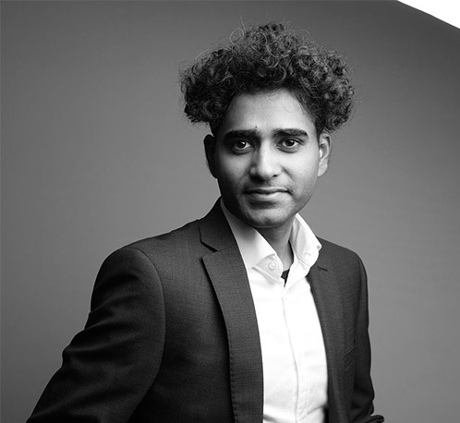
Invited lecture 2: Dr. Mobashir Mohammad
SoC/NUS Alumni. Ph.D. in 2017 under Prof. Mun Choon Chan
Founder of Singapore based startup Ackcio (co-founder is also SoC alumni)
Wireless sensor devices for harsh environments including mines
Notes:
Why do the IoT platforms suffer from this energy challenge? To understand this, we investigate the architecture of the IoT device. We show this architecture in the figure on the slide. It consists of a series of stages that enable us to sense physical phenomena, process and transmit the sensor information through a transceiver such as ZigBee/BLE/LoRa.
This architecture has remained unchanged over the past two decades. We find that during this time, sensors have become exceeding efficient. Today, we find sensors such as an accelerometer or a temperature sensor consumes just a few tens of microwatts of power consumption. However, we find that rest of the architecture components that are shown in red colour remain significantly energy expensive. To understand the reason for this significant energy asymmetry, we look at the following slide.

Slide 6
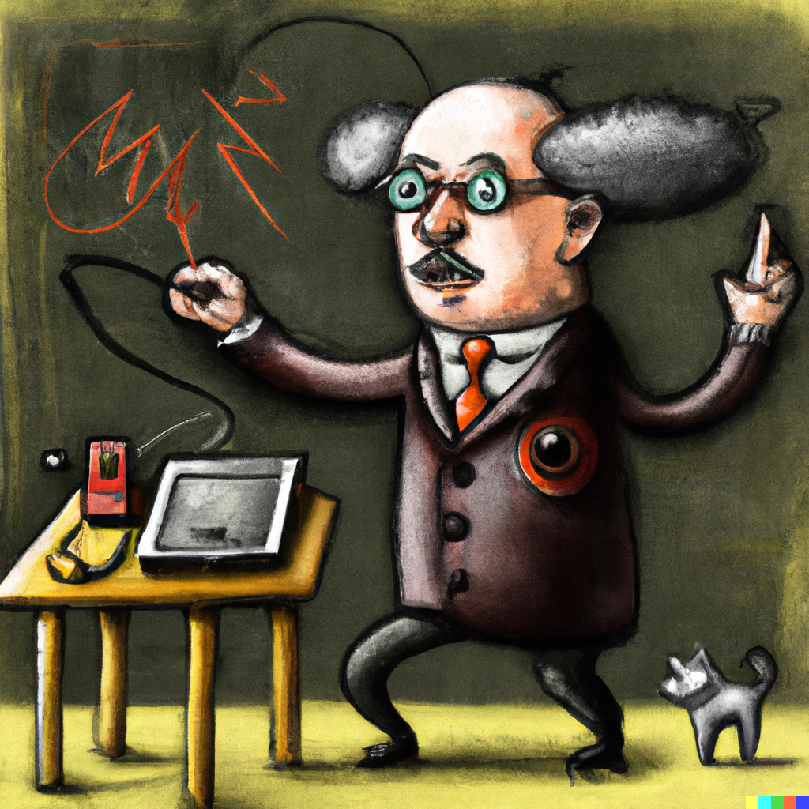
Invited lecture 3: TBD
Notes:
Why do the IoT platforms suffer from this energy challenge? To understand this, we investigate the architecture of the IoT device. We show this architecture in the figure on the slide. It consists of a series of stages that enable us to sense physical phenomena, process and transmit the sensor information through a transceiver such as ZigBee/BLE/LoRa.
This architecture has remained unchanged over the past two decades. We find that during this time, sensors have become exceeding efficient. Today, we find sensors such as an accelerometer or a temperature sensor consumes just a few tens of microwatts of power consumption. However, we find that rest of the architecture components that are shown in red colour remain significantly energy expensive. To understand the reason for this significant energy asymmetry, we look at the following slide.

Slide 7
Learning Objective for Today’s Lecture
Review: last lecture’s topics – signal, modulation
Brief overview of WiFi communication
Long-range, Low-power, wireless communication
Notes:
Why do the IoT platforms suffer from this energy challenge? To understand this, we investigate the architecture of the IoT device. We show this architecture in the figure on the slide. It consists of a series of stages that enable us to sense physical phenomena, process and transmit the sensor information through a transceiver such as ZigBee/BLE/LoRa.
This architecture has remained unchanged over the past two decades. We find that during this time, sensors have become exceeding efficient. Today, we find sensors such as an accelerometer or a temperature sensor consumes just a few tens of microwatts of power consumption. However, we find that rest of the architecture components that are shown in red colour remain significantly energy expensive. To understand the reason for this significant energy asymmetry, we look at the following slide.

Slide 8
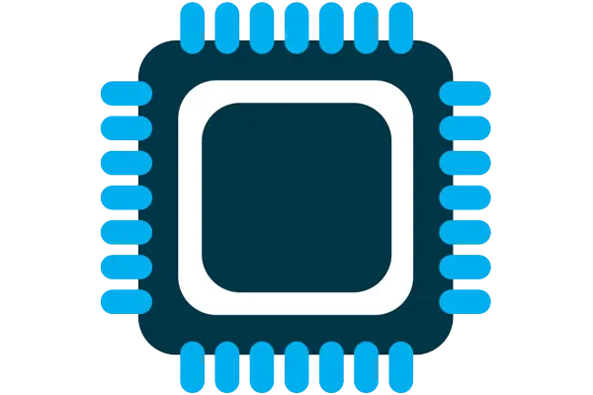



Four major components of IoT device
Computation and Storage
Sensing and Actuation
Power
Wireless Connectivity
Notes:
First, we look at the computational elements, and these consist of a microcontroller or an FPGA. Today, we find that these computational elements consume at least one order of magnitude higher power consumption when compared to the commonly used sensors.
However, we also find that microcontrollers are increasingly becoming energy efficient. We investigate a typical microcontroller that has been used in sensor platforms over the past two decades. We find that energy efficiency has improved by almost two orders of magnitude. Some of the present-generation microcontrollers, such as Ambiq Apollo4 consume just 3 uA/MHz than 330 uA for MSP430 used on platforms such as TelOS B.
If the trend continues, we can expect the microcontrollers to catch up with the sensors and become energy-efficient. This significant improvement is that the digital components are increasing becoming efficient as they follow moore’s law.

Slide 9
Four major components of IoT device
Computation and Storage
Sensing and Actuation
Power
Wireless Connectivity
Notes:
First, we look at the computational elements, and these consist of a microcontroller or an FPGA. Today, we find that these computational elements consume at least one order of magnitude higher power consumption when compared to the commonly used sensors.
However, we also find that microcontrollers are increasingly becoming energy efficient. We investigate a typical microcontroller that has been used in sensor platforms over the past two decades. We find that energy efficiency has improved by almost two orders of magnitude. Some of the present-generation microcontrollers, such as Ambiq Apollo4 consume just 3 uA/MHz than 330 uA for MSP430 used on platforms such as TelOS B.
If the trend continues, we can expect the microcontrollers to catch up with the sensors and become energy-efficient. This significant improvement is that the digital components are increasing becoming efficient as they follow moore’s law.

Slide 10
Administration
Remaining: Three more (?) instructor driven lectures
Computation
Sensing and actuation
Energy sources and power consideration
After the instructor led lectures: Invited lecture series (Graded)
Student seminars and presentations (regarding papers)
Demo day: Student project presentation (Format? TBD)
Notes:
Why do the IoT platforms suffer from this energy challenge? To understand this, we investigate the architecture of the IoT device. We show this architecture in the figure on the slide. It consists of a series of stages that enable us to sense physical phenomena, process and transmit the sensor information through a transceiver such as ZigBee/BLE/LoRa.
This architecture has remained unchanged over the past two decades. We find that during this time, sensors have become exceeding efficient. Today, we find sensors such as an accelerometer or a temperature sensor consumes just a few tens of microwatts of power consumption. However, we find that rest of the architecture components that are shown in red colour remain significantly energy expensive. To understand the reason for this significant energy asymmetry, we look at the following slide.

Slide 11
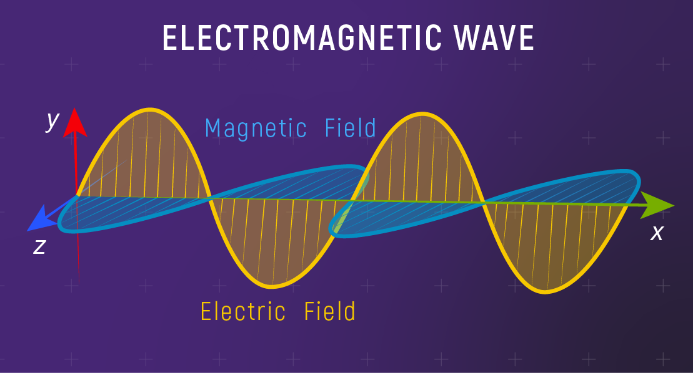
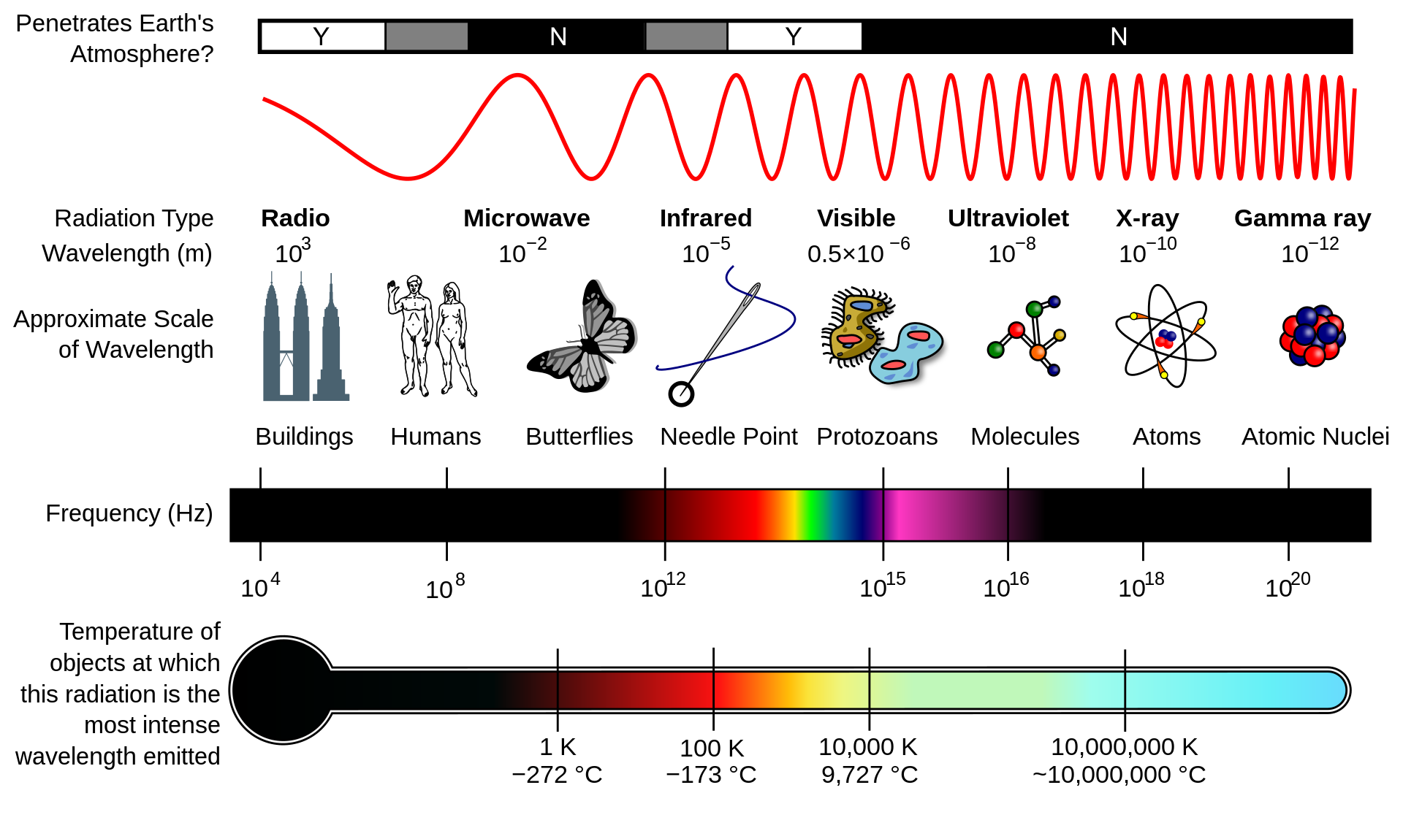
Electromagnetic radiation and spectrum
Electromagnetic waves are synchronized oscillations of electric and magnetic field. There is a periodic change of electric and magnetic field
How often this periodic change occurs dictates the property
Notes:
First, we look at the computational elements, and these consist of a microcontroller or an FPGA. Today, we find that these computational elements consume at least one order of magnitude higher power consumption when compared to the commonly used sensors.
However, we also find that microcontrollers are increasingly becoming energy efficient. We investigate a typical microcontroller that has been used in sensor platforms over the past two decades. We find that energy efficiency has improved by almost two orders of magnitude. Some of the present-generation microcontrollers, such as Ambiq Apollo4 consume just 3 uA/MHz than 330 uA for MSP430 used on platforms such as TelOS B.
If the trend continues, we can expect the microcontrollers to catch up with the sensors and become energy-efficient. This significant improvement is that the digital components are increasing becoming efficient as they follow moore’s law.

Slide 12
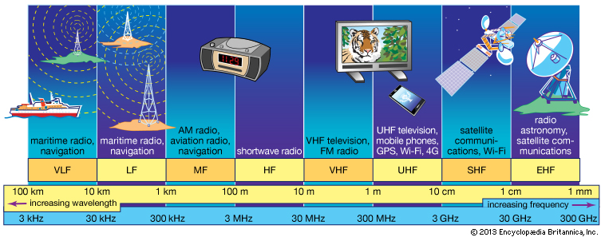
Radio waves are most important part of electromagnetic spectrum
Most (if not all) modern communication relies on radio waves
Frequency range: 30 Hz to 300 GHz
It has the longest wavelength among EM
Notes:
First, we look at the computational elements, and these consist of a microcontroller or an FPGA. Today, we find that these computational elements consume at least one order of magnitude higher power consumption when compared to the commonly used sensors.
However, we also find that microcontrollers are increasingly becoming energy efficient. We investigate a typical microcontroller that has been used in sensor platforms over the past two decades. We find that energy efficiency has improved by almost two orders of magnitude. Some of the present-generation microcontrollers, such as Ambiq Apollo4 consume just 3 uA/MHz than 330 uA for MSP430 used on platforms such as TelOS B.
If the trend continues, we can expect the microcontrollers to catch up with the sensors and become energy-efficient. This significant improvement is that the digital components are increasing becoming efficient as they follow moore’s law.

Slide 13
What are wireless radios?
Radios are electronic devices that enables wireless transmission of signals
Electromagnetic signal is modulated and radiated out of the antenna
Wireless transmissions are then received by a receiver device
Antenna
Radio frequency signal
Radio transmitter
Radio receiver
Notes:
First, we look at the computational elements, and these consist of a microcontroller or an FPGA. Today, we find that these computational elements consume at least one order of magnitude higher power consumption when compared to the commonly used sensors.
However, we also find that microcontrollers are increasingly becoming energy efficient. We investigate a typical microcontroller that has been used in sensor platforms over the past two decades. We find that energy efficiency has improved by almost two orders of magnitude. Some of the present-generation microcontrollers, such as Ambiq Apollo4 consume just 3 uA/MHz than 330 uA for MSP430 used on platforms such as TelOS B.
If the trend continues, we can expect the microcontrollers to catch up with the sensors and become energy-efficient. This significant improvement is that the digital components are increasing becoming efficient as they follow moore’s law.

Slide 14
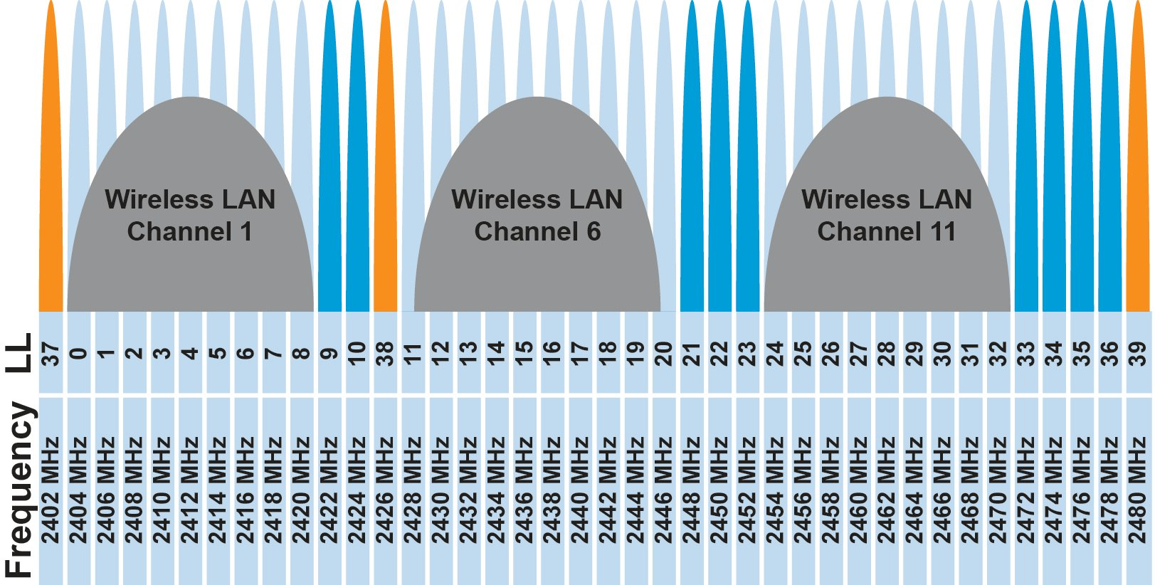
IoT operates in the unlicensed band
902 MHz – 928 MHz
LPWANs
2.4 GHz to 2.5 GHz
WiFi, BLE, Thread
5 GHz
Faster WiFi

Slide 15
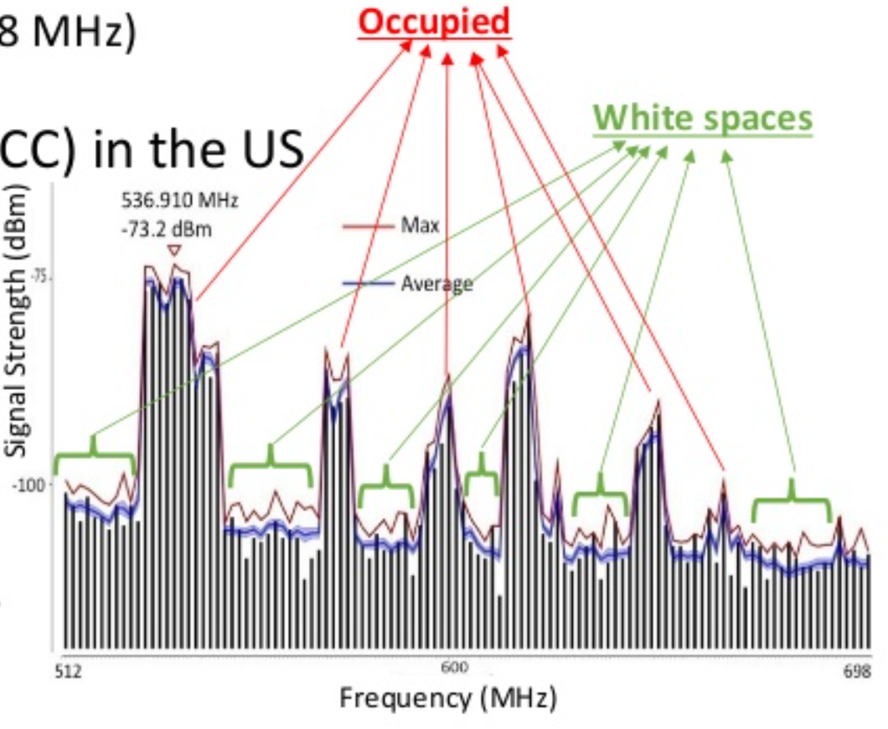
TV whitespaces
Unused TV channels between 54 MHz and 698 MHz
VHF (54-216 MHz)
UHF (470-698 MHz)
6 MHz channel width
Allocated but unused
FCC allows unlicensed use
IF you do not interfere with primary users

Slide 16
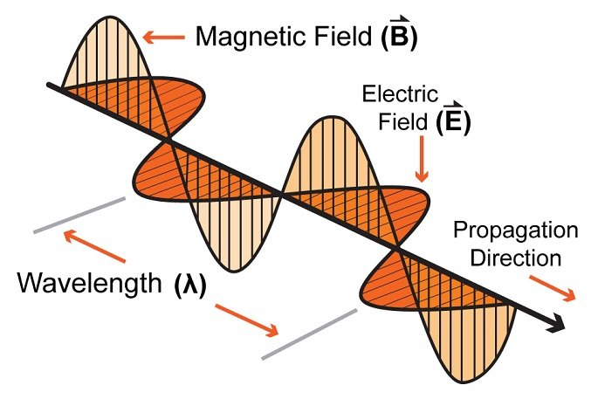
How are radio waves characterized ?
Signal strength
The amount of energy transmitted/received
Signal frequency and bandwidth
Which “channel” the signal is sent on
Signal modulation
How data is encoded in the signal
Notes:
First, we look at the computational elements, and these consist of a microcontroller or an FPGA. Today, we find that these computational elements consume at least one order of magnitude higher power consumption when compared to the commonly used sensors.
However, we also find that microcontrollers are increasingly becoming energy efficient. We investigate a typical microcontroller that has been used in sensor platforms over the past two decades. We find that energy efficiency has improved by almost two orders of magnitude. Some of the present-generation microcontrollers, such as Ambiq Apollo4 consume just 3 uA/MHz than 330 uA for MSP430 used on platforms such as TelOS B.
If the trend continues, we can expect the microcontrollers to catch up with the sensors and become energy-efficient. This significant improvement is that the digital components are increasing becoming efficient as they follow moore’s law.

Slide 17
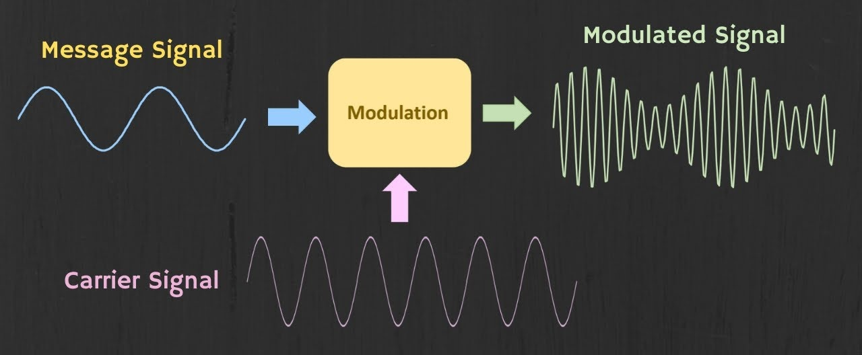
How are radio waves modulated with information ?
Encoding information “baseband" in an analog “carrier” signal
Baseband signal often much lower frequency than carrier
Carrier signal defines the frequency/part of spectrum
Notes:
First, we look at the computational elements, and these consist of a microcontroller or an FPGA. Today, we find that these computational elements consume at least one order of magnitude higher power consumption when compared to the commonly used sensors.
However, we also find that microcontrollers are increasingly becoming energy efficient. We investigate a typical microcontroller that has been used in sensor platforms over the past two decades. We find that energy efficiency has improved by almost two orders of magnitude. Some of the present-generation microcontrollers, such as Ambiq Apollo4 consume just 3 uA/MHz than 330 uA for MSP430 used on platforms such as TelOS B.
If the trend continues, we can expect the microcontrollers to catch up with the sensors and become energy-efficient. This significant improvement is that the digital components are increasing becoming efficient as they follow moore’s law.

Slide 18
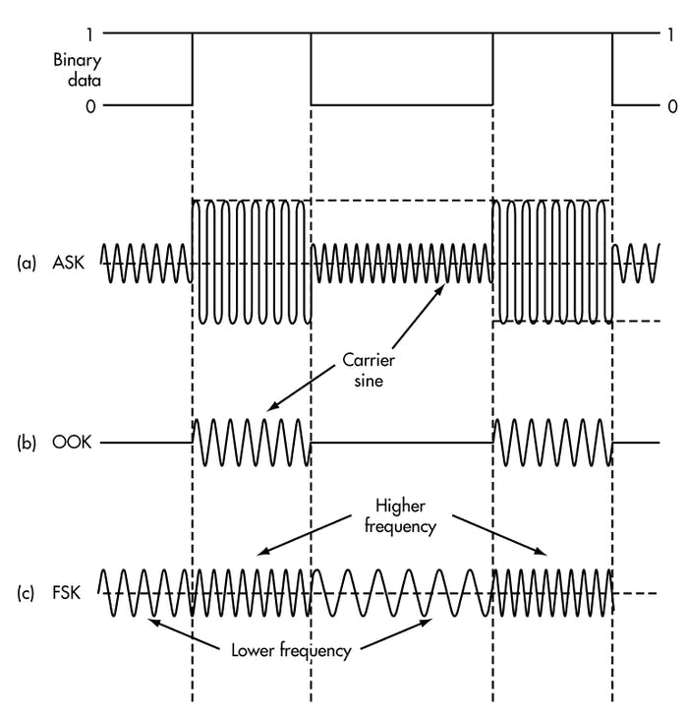
How are radio waves modulated with information
Amplitude-shift Keying (ASK)
Modify amplitude of carrier signal
On-Off Keying (OOK)
Frequency-shift Keying (FSK)
Modify frequency of carrier signal

Slide 19
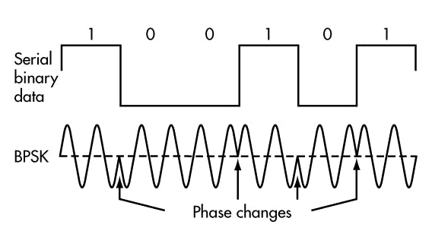
How are radio waves modulated with information
Phase-shift keying (PSK)
Modify phase of carrier signal
Usually differential: the change signifies data
More complicated possibilities exist
QAM (Quadrature Amplitude Modulation) - amplitude and phase shift keying

Slide 20
Learning Objective for Today’s Lecture
Review: last lecture’s topics – signal, modulation
Brief overview of WiFi communication
Long-range, Low-power, wireless communication
Notes:
Why do the IoT platforms suffer from this energy challenge? To understand this, we investigate the architecture of the IoT device. We show this architecture in the figure on the slide. It consists of a series of stages that enable us to sense physical phenomena, process and transmit the sensor information through a transceiver such as ZigBee/BLE/LoRa.
This architecture has remained unchanged over the past two decades. We find that during this time, sensors have become exceeding efficient. Today, we find sensors such as an accelerometer or a temperature sensor consumes just a few tens of microwatts of power consumption. However, we find that rest of the architecture components that are shown in red colour remain significantly energy expensive. To understand the reason for this significant energy asymmetry, we look at the following slide.

Slide 21
Basic facts about WiFi
Most of us know about WiFi! Laptops, mobile phones, other devices?
Covers small area (approx. 10 to 30 meters), Very high speed
The WiFi standard is almost 30 years old!
Notes:
++ While we are deploying an enormously large number of IoT devices, I claim that very little attention is being paid to their energy challenge.
++ Today, most IoT devices are very energy expensive, and consequently, they rely on bulky batteries such as AA/AAA sized batteries for their operation. Even when operating on these batteries, they require frequent replacement of the exhausted batteries. This can be challenging when performed at a massive scale, especially considering that we may have a trillion embedded device deployed in the world.
++ Further, it can also harm the environment. These batteries use toxic chemicals, which means now we can have billions of toxic chemicals laden batteries that would be disposed of in landfills. This is especially important as sustainability has become an essential aspect across the world; in fact, imperial college was celebrating sustainability week.

Slide 22
Basic facts about WiFi
Most of us know about WiFi! Laptops, mobile phones, other devices?
Covers small area (approx. 10 to 30 meters), Very high speed
The WiFi standard is almost 30 years old!
Notes:
++ While we are deploying an enormously large number of IoT devices, I claim that very little attention is being paid to their energy challenge.
++ Today, most IoT devices are very energy expensive, and consequently, they rely on bulky batteries such as AA/AAA sized batteries for their operation. Even when operating on these batteries, they require frequent replacement of the exhausted batteries. This can be challenging when performed at a massive scale, especially considering that we may have a trillion embedded device deployed in the world.
++ Further, it can also harm the environment. These batteries use toxic chemicals, which means now we can have billions of toxic chemicals laden batteries that would be disposed of in landfills. This is especially important as sustainability has become an essential aspect across the world; in fact, imperial college was celebrating sustainability week.

Slide 23
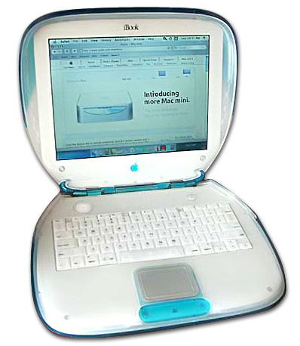
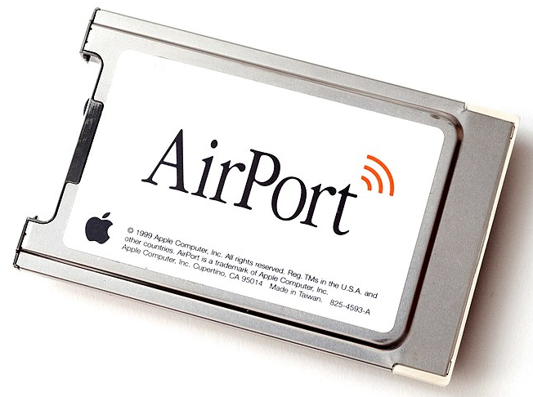
WiFi standard timeline
1985 – US FCC rules ISM band for unlicensed use
1990s – WaveLAN (NCR Corporation, Netherlands)
Wireless ethernet for cashier systems
1997 – 802.11 specification
1999 – 802.11b and 802.11a amendments
1999 – WiFi Alliance formed for certification of devices
1999 – Apple iBook is the first consumer WiFi product
Notes:
++ While we are deploying an enormously large number of IoT devices, I claim that very little attention is being paid to their energy challenge.
++ Today, most IoT devices are very energy expensive, and consequently, they rely on bulky batteries such as AA/AAA sized batteries for their operation. Even when operating on these batteries, they require frequent replacement of the exhausted batteries. This can be challenging when performed at a massive scale, especially considering that we may have a trillion embedded device deployed in the world.
++ Further, it can also harm the environment. These batteries use toxic chemicals, which means now we can have billions of toxic chemicals laden batteries that would be disposed of in landfills. This is especially important as sustainability has become an essential aspect across the world; in fact, imperial college was celebrating sustainability week.

Slide 24
Timeline of development of WiFi standard
 | Protocol | Year | Frequency | PHY | Max Rate | Range
- | 802.11 | 1997 | 2.4 GHz | DSSS/FHSS | 2 Mbps | 20 m
1 | 802.11b | 1999 | 2.4 GHz | DSSS | 11 Mbps | 35 m
2 | 802.11a | 1999 | 5 GHz | OFDM | 54 Mbps | 35 m
3 | 802.11g | 2003 | 2.4 GHz | OFDM | 54 Mbps | 38 m
4 | 802.11n | 2009 | 2.4/5 GHz | OFDM + MIMO | 600 Mbps | 70 m
5 | 802.11ac | 2013 | 5 GHz | OFDM + MU-MIMO [downlink only] | 3.4 Gbps | 35 m
6 | 802.11.ax | 2021 | 2.5/5 [/6] GHz | OFDMA + MU-MIMO | 9.6 Gbps | 35 m
Notes:
++ While we are deploying an enormously large number of IoT devices, I claim that very little attention is being paid to their energy challenge.
++ Today, most IoT devices are very energy expensive, and consequently, they rely on bulky batteries such as AA/AAA sized batteries for their operation. Even when operating on these batteries, they require frequent replacement of the exhausted batteries. This can be challenging when performed at a massive scale, especially considering that we may have a trillion embedded device deployed in the world.
++ Further, it can also harm the environment. These batteries use toxic chemicals, which means now we can have billions of toxic chemicals laden batteries that would be disposed of in landfills. This is especially important as sustainability has become an essential aspect across the world; in fact, imperial college was celebrating sustainability week.

Slide 25
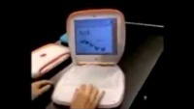
iBook (1999)
Notes:
++ While we are deploying an enormously large number of IoT devices, I claim that very little attention is being paid to their energy challenge.
++ Today, most IoT devices are very energy expensive, and consequently, they rely on bulky batteries such as AA/AAA sized batteries for their operation. Even when operating on these batteries, they require frequent replacement of the exhausted batteries. This can be challenging when performed at a massive scale, especially considering that we may have a trillion embedded device deployed in the world.
++ Further, it can also harm the environment. These batteries use toxic chemicals, which means now we can have billions of toxic chemicals laden batteries that would be disposed of in landfills. This is especially important as sustainability has become an essential aspect across the world; in fact, imperial college was celebrating sustainability week.

Slide 26
IEEE standard for LPWANs
n.b.
802 = “area networking”
.3 = “LANs”
.11 = “Wireless LANs”
.15 = “PANs”
802.11ah (HaLow) standard in 2016
First real hardware in 2020
Still not in real-world use yet
Focus on the indoor-to-outdoor scenario
Medium range (maximum 1 km)
915 MHz communication
NOT interoperable with other 802.11 access points and devices
Theoretically up to 356 Mbps
Practically, most devices are expected to implement 150 kbps to 8 Mbps

Slide 27
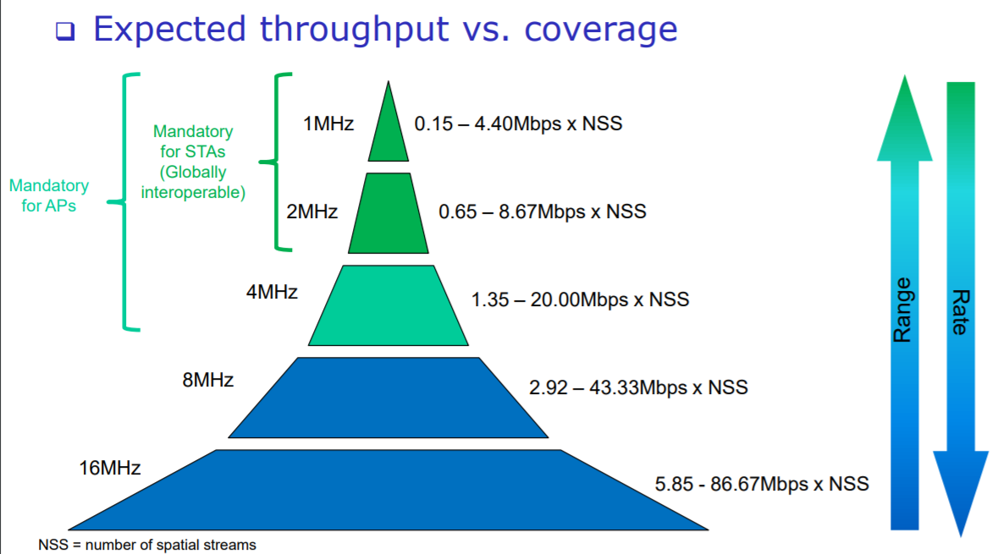
802.11ah allows multiple bandwidth allocations

Slide 28
Learning Objective for Today’s Lecture
Review: last lecture’s topics – signal, modulation
Brief overview of WiFi communication
Long-range, Low-power, wireless communication
Notes:
Why do the IoT platforms suffer from this energy challenge? To understand this, we investigate the architecture of the IoT device. We show this architecture in the figure on the slide. It consists of a series of stages that enable us to sense physical phenomena, process and transmit the sensor information through a transceiver such as ZigBee/BLE/LoRa.
This architecture has remained unchanged over the past two decades. We find that during this time, sensors have become exceeding efficient. Today, we find sensors such as an accelerometer or a temperature sensor consumes just a few tens of microwatts of power consumption. However, we find that rest of the architecture components that are shown in red colour remain significantly energy expensive. To understand the reason for this significant energy asymmetry, we look at the following slide.

Slide 29
Long-range,low-data needs are not easily met
WiFi
Data
Throughput
Range

Slide 30
Long-range,low-data needs are not easily met
WiFi
Data
Throughput
Bluetooth
BLE
Zigbee
Range

Slide 31
Long-range,low-data needs are not easily met
WiFi
Higher Power & Higher Cost
Data
Throughput
Bluetooth
BLE
Zigbee
Lower Power & Lower Cost
Range

Slide 32
Long-range,low-data needs are not easily met
WiFi
4G
Higher Power & Higher Cost
3G
Data
Throughput
2G
Bluetooth
2G
BLE
Zigbee
Lower Power & Lower Cost
Range

Slide 33
Long-range,low-data needs are not easily met
WiFi
4G
Higher Power & Higher Cost
3G
Data
Throughput
Bluetooth
2G
Low-Power Wide-Area Networks
BLE
Zigbee
Lower Power & Lower Cost
Range

Slide 34
Long-range, Low-power: design choices
How would you design PHY for long-range, low-power ?

Slide 35
Long-range, Low-power: design choices
How would you design PHY for long-range, low-power ?
Modulation
Tx Power
Carrier Frequency Band
Data Throughput
Channel Bandwidth

Slide 36
Long-range, Low-power: design choices
How would you design PHY for long-range, low-power ?
Modulation
Unclear. Perhaps, not complicated or complex (simple devices)
Tx Power
High (much higher than 0 dBm)
Carrier Frequency Band
Low (something lower than 2.4 GHz, 915 MHz or lower?)
Data Throughput
Low (much lower than 1 Mbps)
Channel Bandwidth
Unclear. Likely smaller for lower frequency carrier.

Slide 37
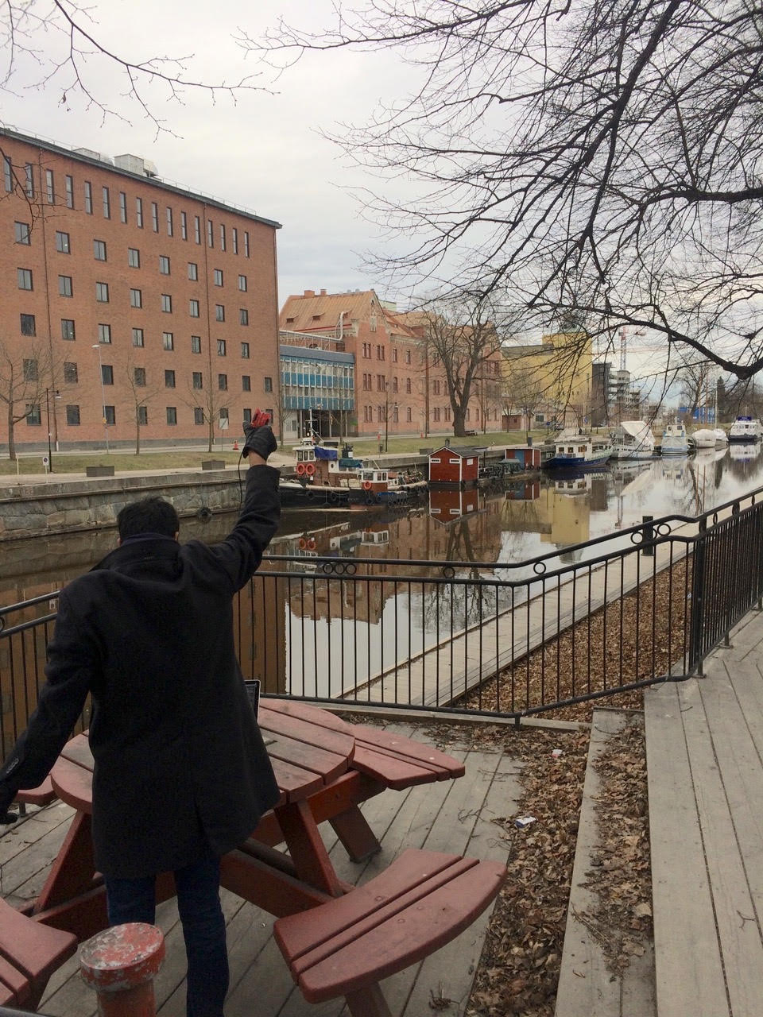
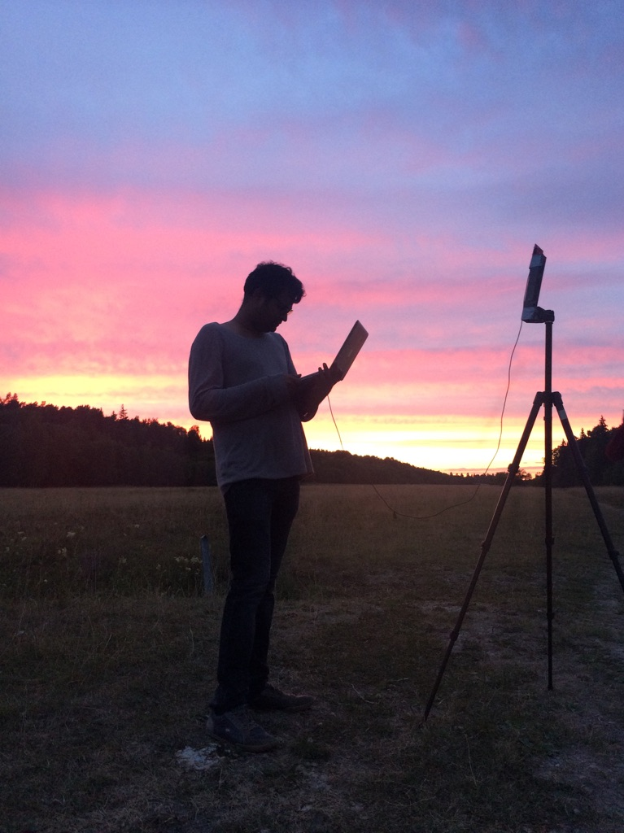
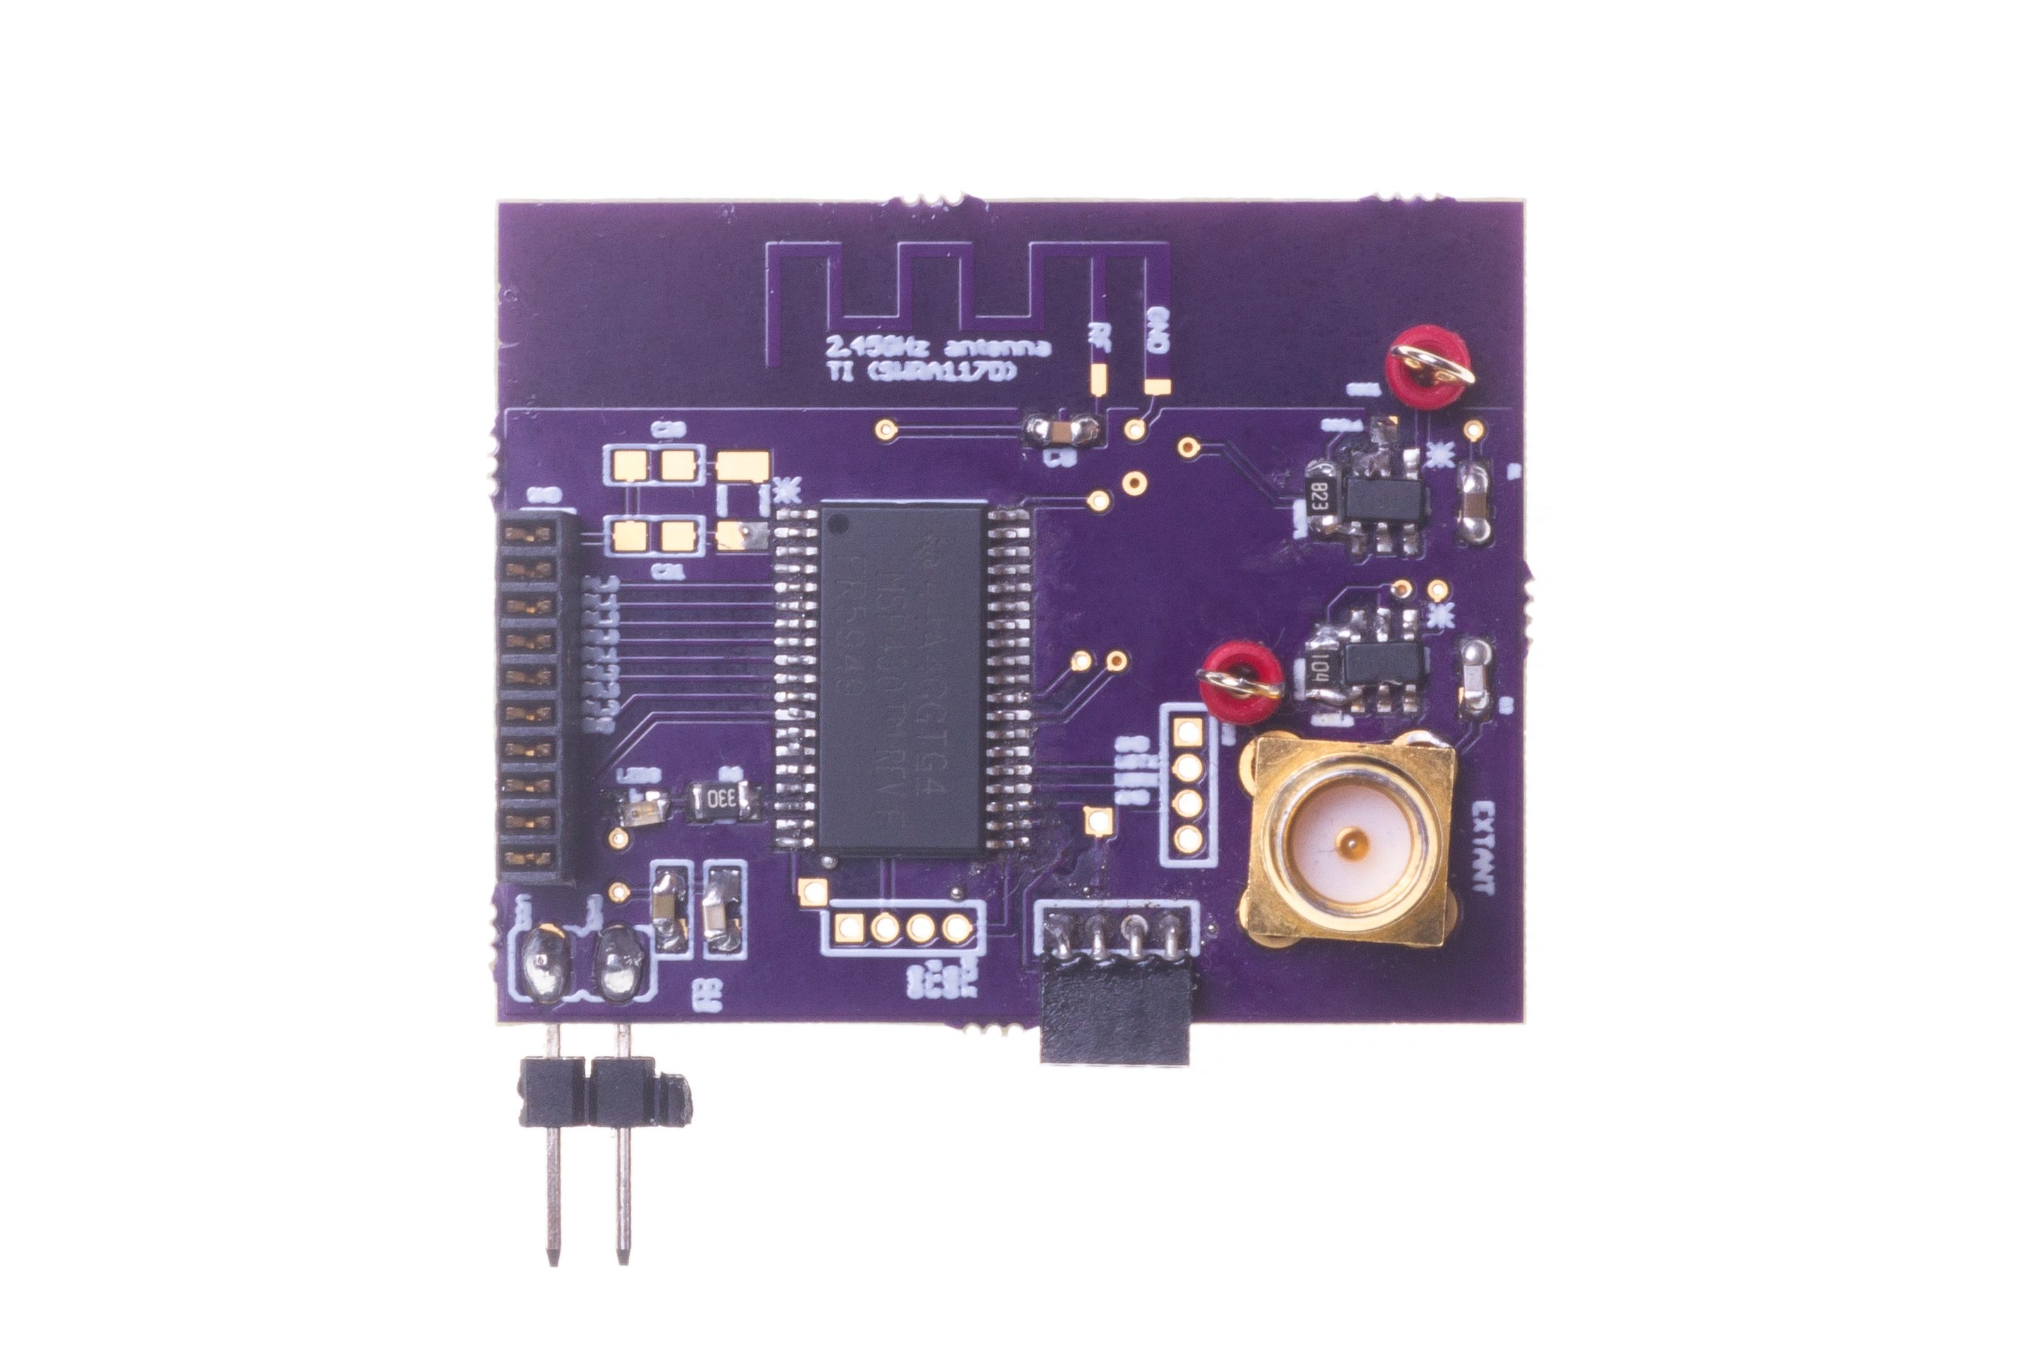
Long range depends on receiver sensitivity and transmit power
Receiver sensitivity improves with lower bitrate/bandwidth
Low bitrate, narrow band signals, very high receive sensitivity
Large transmit power, high receive sensitivity -> Very large range
LoRea: -124 dBm at < 1 kbps, 2 FSK

Slide 38
Long range backscatter transmissions using LoRea
LoRea is a long range, low-power, and low-cost backscatter architecture
System Overview
Backscatter Tag Hardware Prototype
(Peak Power of 70 µW)
Varshney et al. ”LoRea: A Backscatter architecture that achieves a long communication range” ACM SENSYS 2017
Notes:
+ Over the past several years, I have designed systems that overcome these critical limitations that have hindered the backscatter systems and have the prevented widespread adoption of the backscatter mechanisms on the Internet of Things devices. One of these systems is LoRea.
+ LoRea was presented at ACM SENSYS, which is a flagship conference in the area of embedded sensor systems. I show the architecture of LoRea on the left-hand figure on the slide. It consists of one or more commodity devices such as a smartphone or Wi-Fi router that provides the necessary carrier signal to support backscatter transmissions, a low-power backscatter tag that I had designed and transmit at a peak power of 70uw, and one or more receiver of backscatter transmissions.
+ The key highlight of LoRea was that it could achieve a significantly larger communication range than existing systems, was designed using off the shelf components and cost (few tens of USDs). Further, the backscatter tag could achieve this capability at orders of magnitude lower energy than commercially available radio transceivers.
+ How did LoRea achieve this capability? We would describe next.

Slide 39
LoRea backscatter narrow bandwidth transmissions which improves sensitivity
Key idea: Receiver sensitivity improves as we lower bandwidth
Lower bitrate (2.9 kbit/s) generates narrow bandwidth transmissions
Low bitrates are not detrimental to most sensing applications
Operating frequency | Bandwidth
868 MHz | 13 kHz
2.4 GHz | 180 kHz
Notes:
+ The third design element that we incorporate in LoRea enables us to significantly improve the communication range. We use key idea that the receiver sensitivity improves as we lower the bandwidth and bitrate. In LoRea, we intentionally generate narrow bandwidth transmissions, in fact, in LoRea we transmit at 2.9 Kbits and generate transmissions of 13 KHz bandwidth. Just compare this to WiFi which takes tens of MHz of bandwidth for transmissions.
+ This design element allows us to use highly sensitive radio transceievers for reception of backscatter transmissions, in fact, we use CC1310 which supports a very high sensitivity of -124 dBm which enables us to support very high link budget and communication range.
+ You might wonder: Doesn’t this impact the application scenarios? No, it does not. This is because most sensing applications transmit only small bits of information periodically, and hence the lower bitrate is not detrimental to their operation.

Slide 40
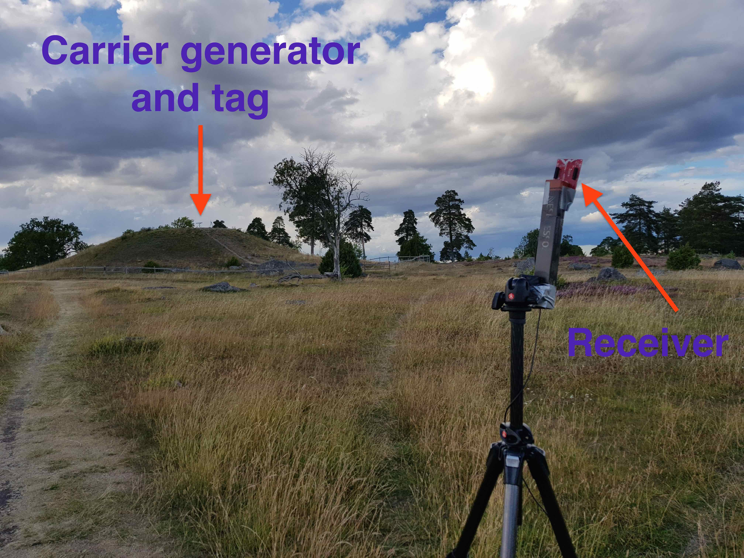
LoRea achieved the highest demonstrated range
Receive up to a distance of 3.4 kilometers from tag
Highest demonstrated range. Outperforms leading labs/universities
Experiment Setup
(On a small hill)
Receiving backscatter transmissions kilometers away from setup
Notes:
Hence, to find the maximum range we could achieve with our system, we took the entire setup outside Uppsala to an open space. We kept the backscatter setup on top of a small hill, and investigated the maximum communication range that we could support.
Performing these experiments was significantly challenging, as we would setup experiment in the daytime, and by the time we would finish collecting the link metrics, it would be dawn. We also had to walk significant distances with equipment.
We found that we could communicate up to a distance of 3.4 km while consuming tens of microwatts of power for wireless transmissions at the backscatter tag. Achieving such high communication range was considered challenging or even infeasible with backscatter mechanism, and LoRea helped overturn notion that backscatter is a low range transmission mechanism.

Slide 41
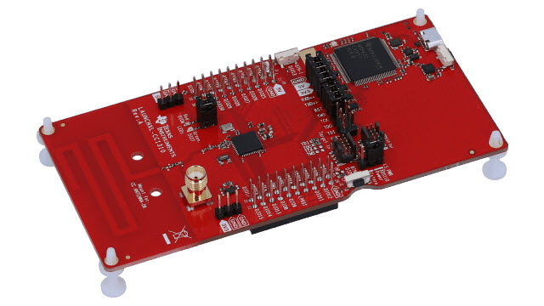
LoRea bridges the energy asymmetry between communication (TX), sensing and processing
Off-the-shelf hardware for transmission and receptions. Tens of USD
Overturn notion that backscatter is a short-range transmission mechanism
Component | Power Consumption
LoRea (Transmissions) | 70 µW (868 MHz)
Conventional Transceiver | Tens to hundreds of mW’s
Microcontroller (Apollo3) | 100s of µW’s
Sensors | Few to tens of µW’s
LoRea transmits at similar power consumption as a sensor
Texas Instruments CC1310 Launchpad: Receiver
Backscatter Tag Hardware Prototype
(Peak Power of 70 µW)
Notes:
+ Thus, with LoRea, we were able to design a backscatter system that was able to overcome the range and cost limitations that had limited all the existing backscatter system, and had hindered the widespread usage of the mechanism on the IoT devices
.
+ In fact, the backscatter tag even though it was designed using off-the-shelf components is orders of magnitude more efficient than commercial transceivers while supporting orders of magnitude lower power consumption.
+ the entire backscatter setup costs just few tens of USDs, which dramatically lowers the cost of infrastructure required to support the backscatter tags and carrier emitter device.

Slide 42
Break! (5 minutes)
Notes:
++ Over the past few years, I have designed several backscatter and beyond backscatter systems that precisely overcome these critical challenges that have limited the widespread deployment of backscatter on IoT devices.
++ The research vision that I have pursued and would like to pursue as a faculty member is to enable a massive deployment of IoT devices by bridging the energy asymmetry between sensing, computation and communication blocks by designing novel platforms and communication mechanisms. I am going to describe some of my research contributions next.

Slide 43
Learning Objective for Today’s Lecture
Review: last lecture’s topics – signal, modulation
Brief overview of WiFi communication
Long-range, Low-power, wireless communication
Notes:
Why do the IoT platforms suffer from this energy challenge? To understand this, we investigate the architecture of the IoT device. We show this architecture in the figure on the slide. It consists of a series of stages that enable us to sense physical phenomena, process and transmit the sensor information through a transceiver such as ZigBee/BLE/LoRa.
This architecture has remained unchanged over the past two decades. We find that during this time, sensors have become exceeding efficient. Today, we find sensors such as an accelerometer or a temperature sensor consumes just a few tens of microwatts of power consumption. However, we find that rest of the architecture components that are shown in red colour remain significantly energy expensive. To understand the reason for this significant energy asymmetry, we look at the following slide.

Slide 44
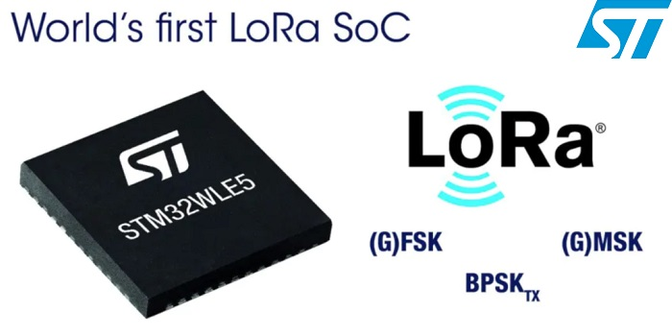
LoRaWAN
Open communication standard built with proprietary LoRa PHY
Operates in the unlicensed band
Low data rate (1-20 kbps) and long range (~5 km)
Most popular LPWAN protocol
Academic research and industry involvement

Slide 45
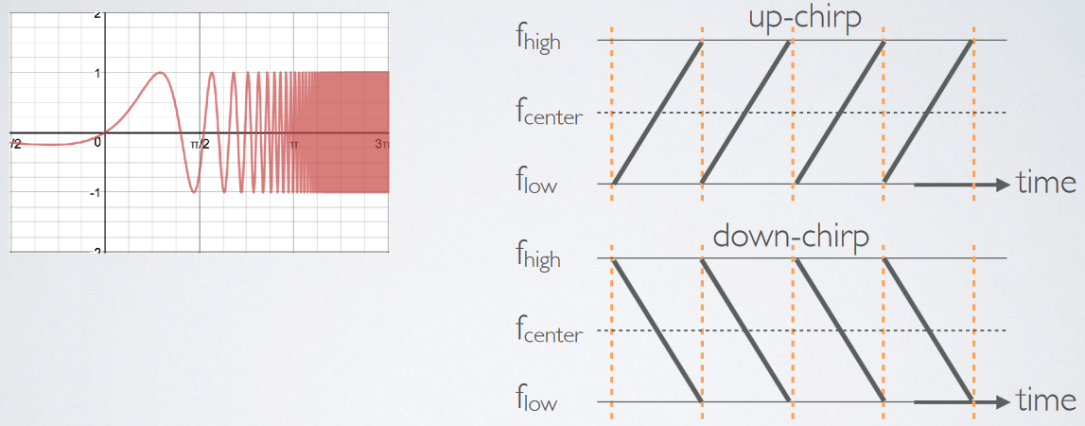
LoRa employs a different modulation scheme
Chirp Spread Spectrum (CSS): Modulation technique where frequency is varied linearly from lowest to highest within a channel

Slide 46
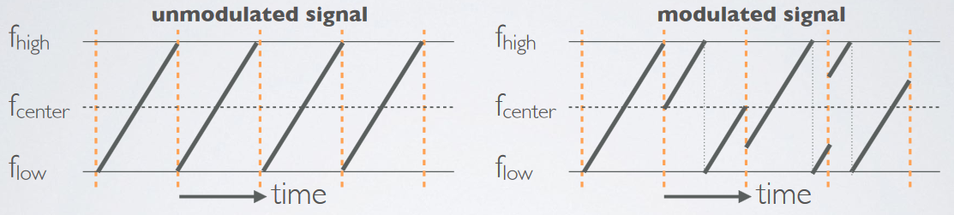
Chirp Spread Spectrum
Data is modulated in the starting and ending points of chirp
Frequency increases linearly, modulo bounds of the channel

Slide 47
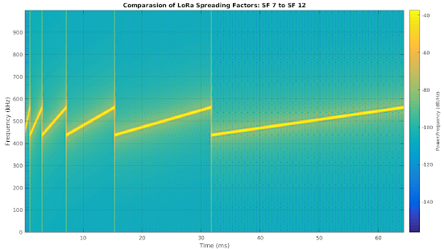
Spreading factor of CSS modulation
Spreading Factor is essentially the rate-of-change of frequency
Slope of the line
Lower values of spreading factor (steeper slope) are faster data rate
Important: different spreading factors are (mostly) orthogonal!
Two can overlap in time, space, and channel without a collision

Slide 48
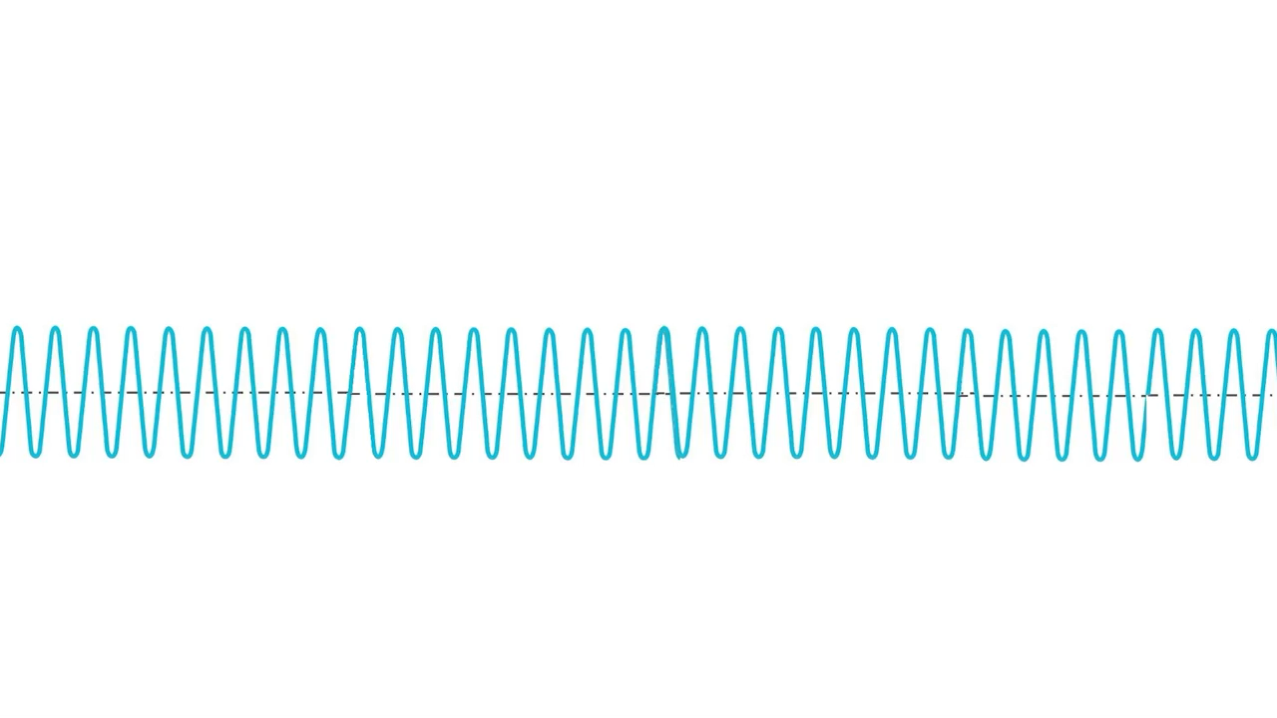
Overview of CSS (brief video)

Slide 49
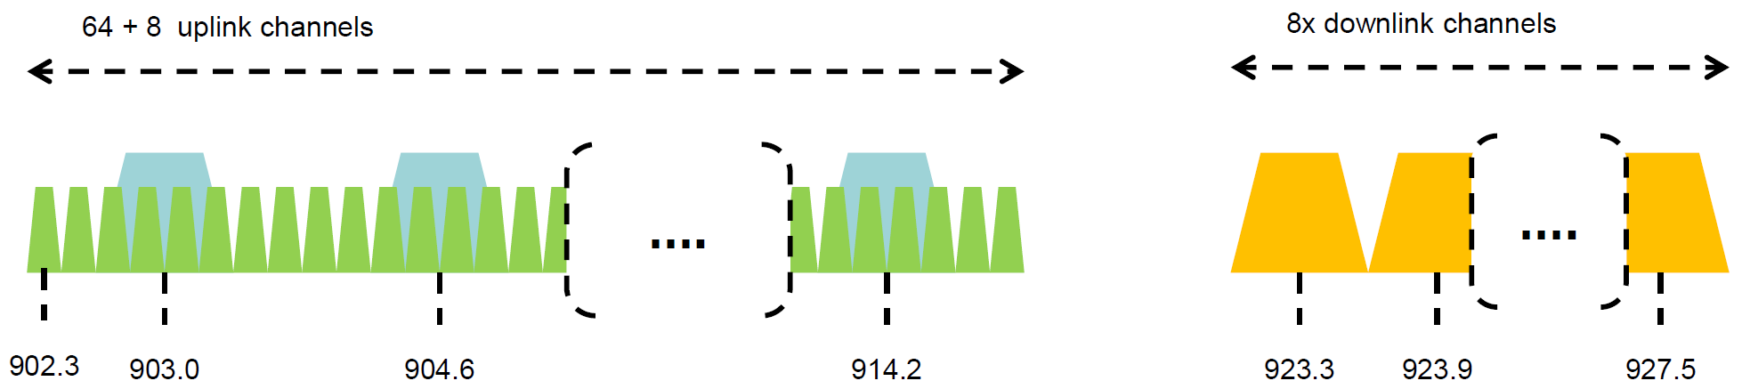
Channel allocation for LoRa
Sixty-four, 125 kHz uplink channels
Frequency Hopping over the 64 uplink channels
Plus eight, 500 kHz overlapping uplink channels (not well used in practice)
Eight, 500 kHz downlink channels

Slide 50
LoRa data rates
Data Rate Index | Spreading Factor | Bit Rate
125 kHz Uplink Rates
0 | SF10, 125 kHz | 980 bps
1 | SF9, 125 kHz | 1760 bps
2 | SF8, 125 kHz | 3125 bps
3 | SF7, 125 kHz | 5470 bps
500 kHz Uplink Rates
4 | SF8, 500 kHz | 12500 bps
500 kHz Downlink Rates
8 | SF12, 500 kHz | 980 bps
9 | SF11, 500 kHz | 1760 bps
10 | SF10, 500 kHz | 3900 bps
11 | SF9, 500 kHz | 7000 bps
12 | SF8, 500 kHz | 12500 bps
13 | SF7, 500 kHz | 21900 bps
Data rate depend on channel in use, spreading factor
64-channel uplink
1-5 kbps data rate

Slide 51
LoRa transmissions are received on gateway
No synchronization with the end devices
Instead listen to entire bandwidth simultaneously (12 MHz total)
Recognize preambles and allocate a hardware to decode packet
Normal gateways: 8 decoders/ Good gateways: 64 decoders

Slide 52
LoRa link budget and transmission range
Typical TX power 20 dBm
Up to 30 dBm for 64-channel hopping
Up to 26 dBm for 8-channel hopping
Receive sensitivity -119 dBm/-146 dBm (highest SF)
Compare to -100 dBm for 802.15.4 and -95 dBm for BLE
Resulting range is kilometers in urban environments

Slide 53
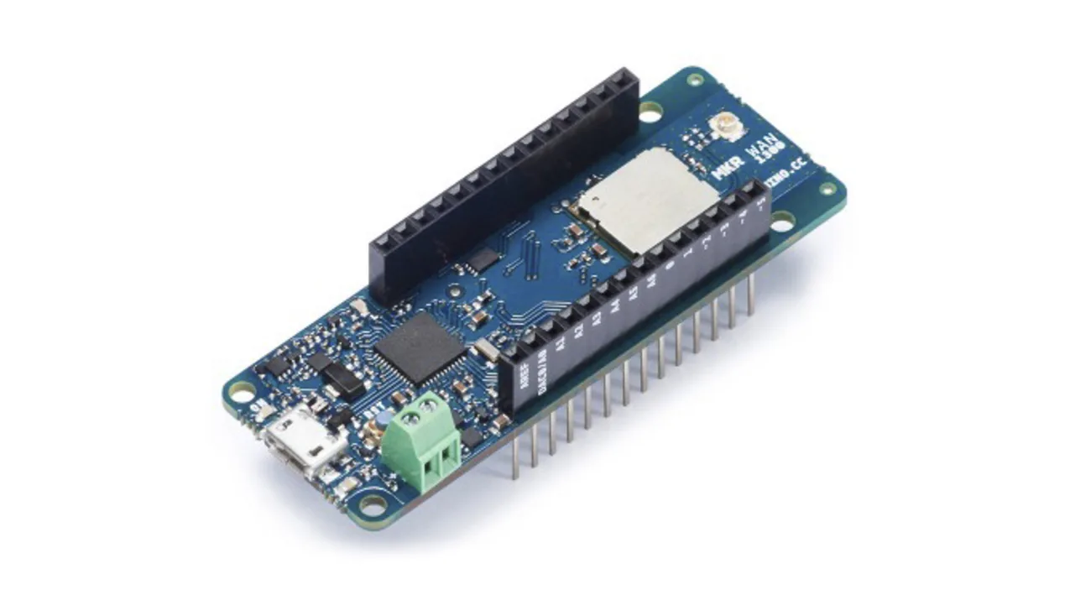
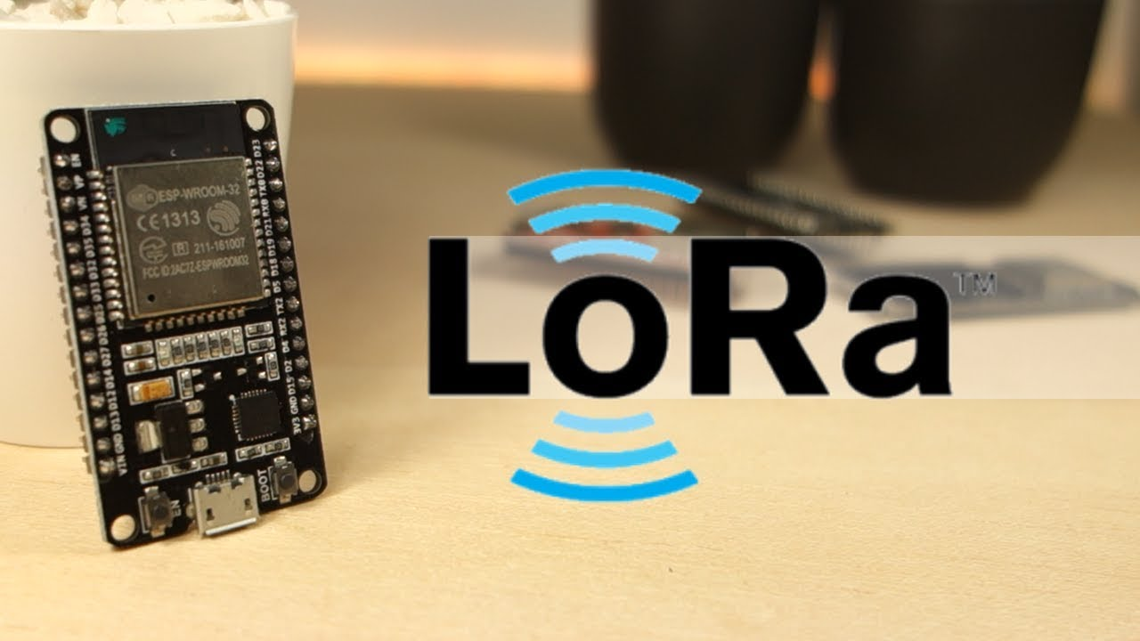
You can build your own LoRa network
Easy-to-use, off-the-shelf hardware available (tens of USD)
Could be useful for projects that you may do in this course

Slide 54
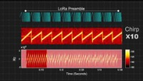
Very low-power, battery-free, LoRa

Slide 55
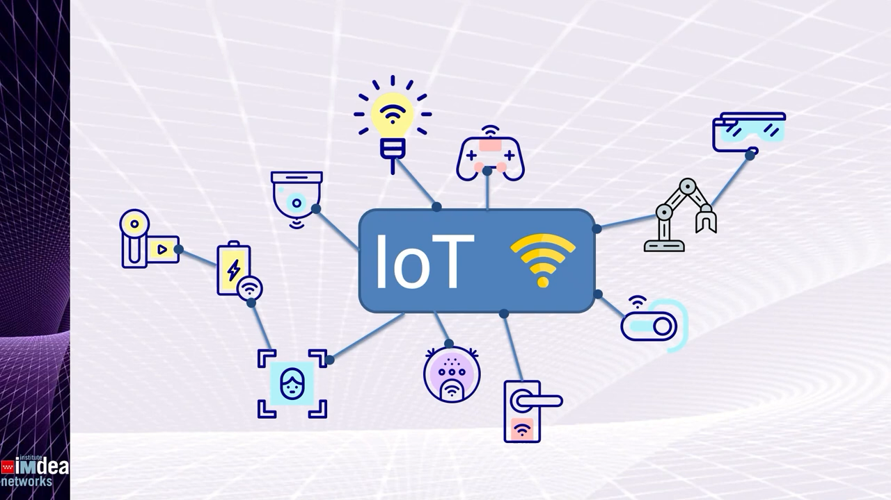
Very low-power, battery-free, LoRa

Slide 56


LoRaWAN network providers
Network provides with a deployment of gateways
The Things Network (predominantly in Europe)
Helium
Any can buy and install their own gateway, which serves everyone
Microtransactions to pay for communication

Slide 57
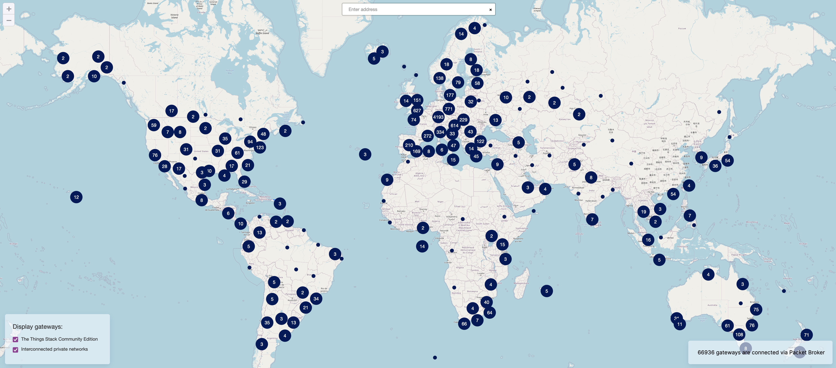
TTN Scale [Jan 2022]

Slide 58
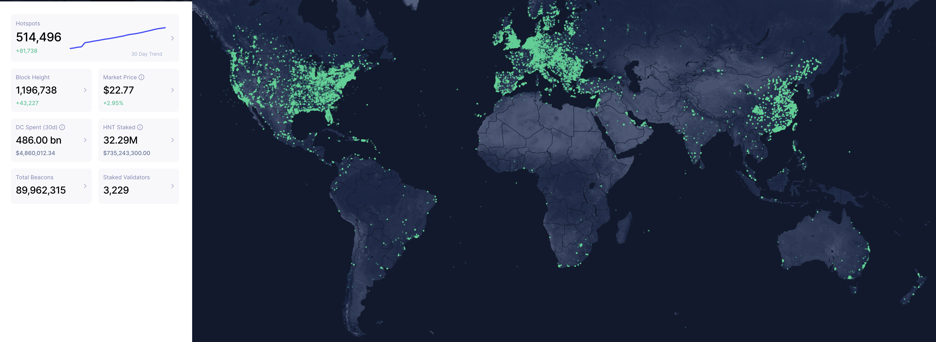
Helium Scale [Jan 2022]

Slide 59

Things Network

Slide 60
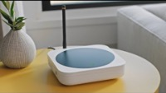
Helium Network

Slide 61
Readings due for third week of September
Helium overview (not to be submitted): Helium whitepaper
Federated Infrastructure: Usage, Patterns, and Insights from “The People’s Network” – ACM IMC 2021 (To be submitted)
Notes:
Backscatter communication actually help us overcome this limitation

Slide 62
CS 6204 - Advanced Topics in Networking
Ambuj Varshney
ambujv@nus.edu.sg
http://ambuj.se
Notes:
Good morning/afternoon everyone. Thank you for inviting me for giving this talk.
In this talk, I will describe my effort to design ubiquitous Internet of Things systems.
In the end of the talk: I will cover some of the future research directions that I would like to address as a faculty member.

